Slide 1


Digital Image Processing
A2 Slot
Underwater Image Enhancement Using ResUNet
Deep Learning Approach with Perceptual Loss
Zayan Zubair (22BCE1100)
KS Suryanarayan (22BCE1394)
Prince Gudala (22BCE1753)

Slide 2

Digital Image Processing
A2 Slot
Objective
The goal of this project is to enhance underwater images using a deep learning-based approach that improves both visual quality and quantitative image fidelity.
🔹 Specifically, we aim to:
Remove underwater image distortions such as color cast, haze, and loss of detail
Recover textures and structural features lost due to scattering and absorption
Maximize image quality metrics like PSNR (Peak Signal-to-Noise Ratio) and SSIM (Structural Similarity Index)
🔹 Additionally, we compare our model’s performance with existing baseline methods (including a published IEEE paper that uses classical image formation models).

Slide 3
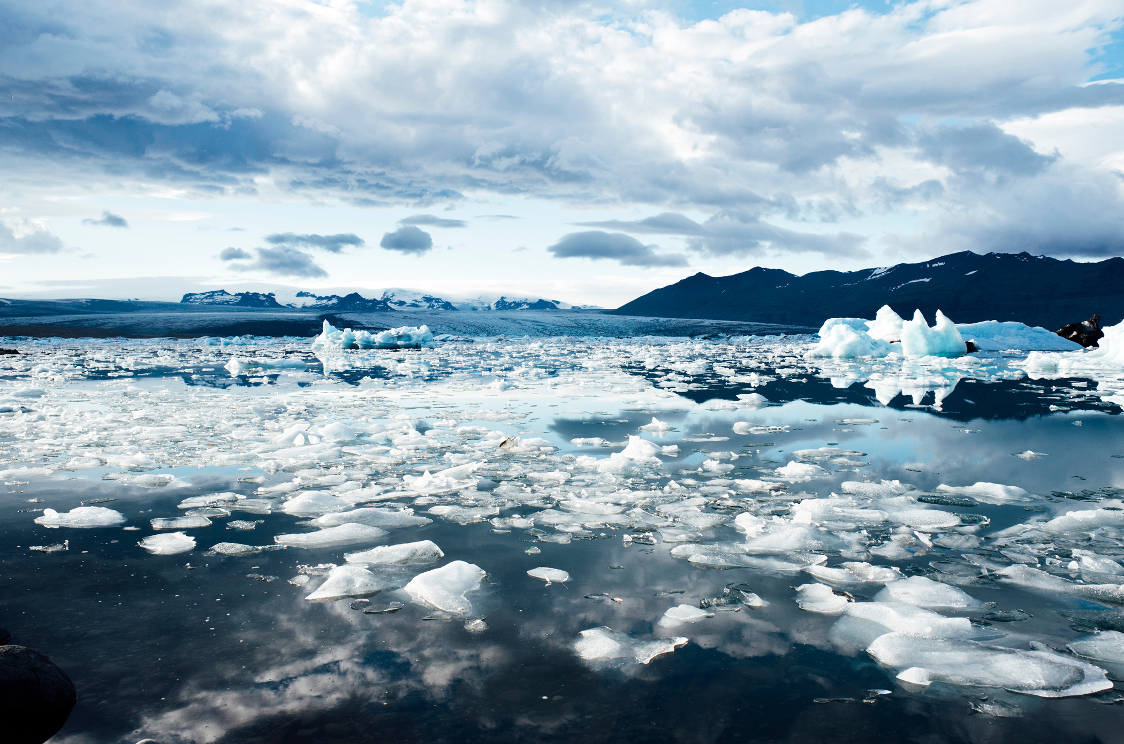
Digital Image Processing
A2 Slot
Dataset
We used the UIEB (Underwater Image Enhancement Benchmark) dataset, which provides:
Real-world underwater images (raw)
High-quality reference images (clean), manually selected or post-processed
Designed specifically for image enhancement benchmarking
🔹 Dataset Preparation:
Used paired images: Raw (input) and Clean (ground truth)
Resized all images to 256×256 pixels for uniformity
Normalized pixel values to [0, 1] for neural network compatibility
Implemented a custom PyTorch Dataset class to load and serve the image pairs efficiently during training

Slide 4
Digital Image Processing
A2 Slot
Model Architecture
We use a ResUNet, which combines the strengths of:
U-Net → Encoder–decoder with skip connections to retain spatial detail
ResNet blocks → Improve gradient flow and focus on residual learning
Architecture Highlights:
Encoder: Downsamples features while capturing semantic information
Bottleneck: Learns deep abstract representations
Decoder: Upsamples and reconstructs enhanced image
Skip connections: Bridge encoder & decoder layers to preserve fine details
Output layer: Produces a 3-channel (RGB) enhanced image using Sigmoid activation
Advantages over a plain Autoencoder:
Retains textures, edges, and color transitions
Prevents over-smoothing
Easier to train due to residual connections

Slide 5
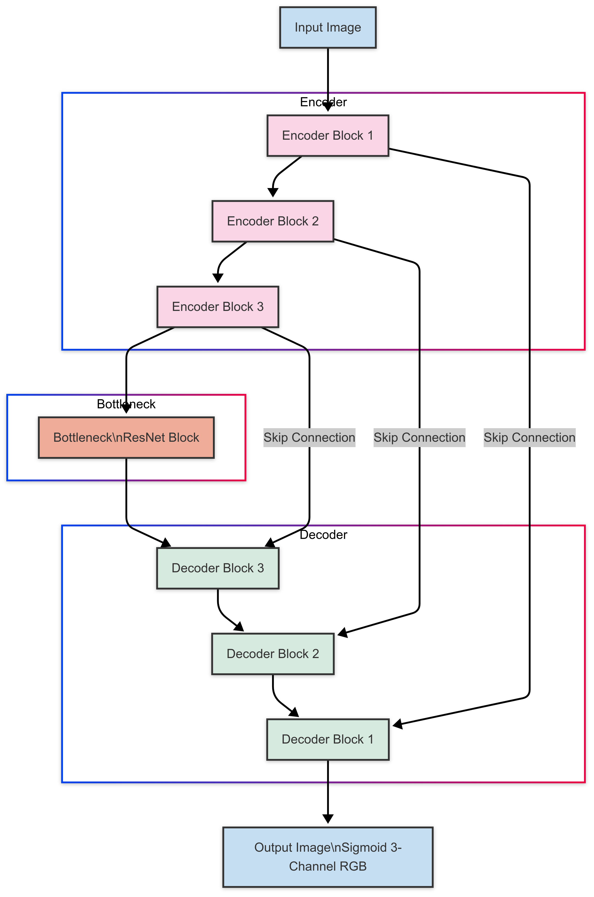

Slide 6
Digital Image Processing
A2 Slot
Loss Function
To enhance both pixel accuracy and perceptual quality, we use a combination of three loss functions:
MSE Loss (Mean Squared Error)
Minimizes pixel-wise difference between prediction and ground truth
Directly improves PSNR (Peak Signal-to-Noise Ratio)
SSIM Loss (Structural Similarity Index)
Encourages preservation of structural information like edges, texture, and contrast
Helps maintain overall image coherence
Perceptual Loss (VGG16-based)
Compares feature maps from a pretrained VGG network
Encourages texture, contrast, and fine detail restoration
🔹 Final Loss Function: Total Loss = α × MSE + β × (1 - SSIM) + γ × Perceptual
🔹 Selected Weights: α = 0.7, β = 0.2, γ = 0.1 (tuned for high PSNR + perceptual sharpness

Slide 7
Digital Image Processing
A2 Slot
Training Setup
Training Configuration
Training Pipeline
Hardware
Framework: PyTorch
Model: ResUNet (with residual blocks and skip connections)
Input Size: 256×256×3 (RGB)
Optimizer: Adam (learning rate = 1e-4)
Batch Size: 8
Epochs: 50
Scheduler: ReduceLROnPlateau (monitors validation loss and reduces LR on plateau)
Noisy input → ResUNet → Enhanced output
Compared with clean ground truth
Total loss (MSE + SSIM + Perceptual) minimized via backpropagation
Evaluation metrics: PSNR, SSIM
Trained on GPU with CUDA support for faster convergence

Slide 8
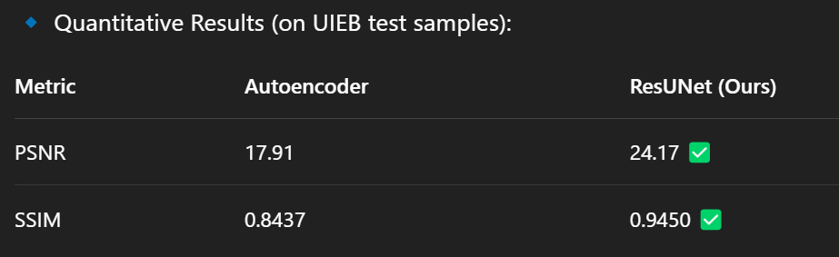
Digital Image Processing
A2 Slot
Results
Visual Improvements:
Sharper textures and edges
Reduced color distortion and haze
Better preservation of marine structures and contrast
Observations:
ResUNet outperforms basic autoencoder in both visual quality and metrics
Combined loss function plays a crucial role in structural and perceptual enhancement
Results approach state-of-the-art performance on UIEB

Slide 9
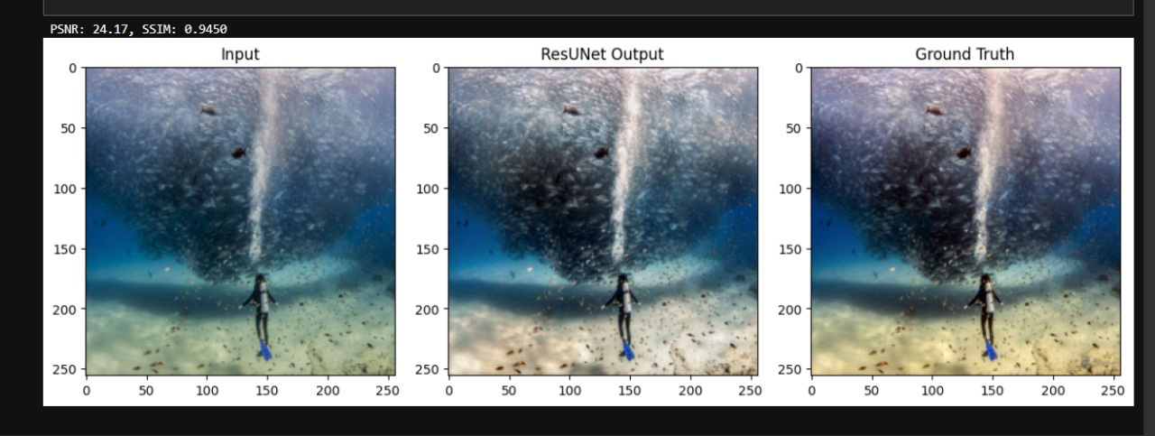
Digital Image Processing
A2 Slot
Visual Comparision

Slide 10
Digital Image Processing
A2 Slot
Future Improvements
Add PCQI Metric
Evaluate contrast-based visual quality
Complements PSNR and SSIM
Fine-tune Loss Weights
Optimize α, β, γ for even better PSNR/SSIM
Possibly use adaptive loss weighting
Try Advanced Architectures
ResUNet++ with attention modules
Integration of CBAM or squeeze-and-excitation blocks
Multi-Scale & Larger Images
Train at multiple resolutions (e.g., 256×256 + 512×512)
Improve generalization across scene depths
Expand to Real-Time or Video Enhancement
Apply model to underwater video frames
Smooth temporal consistency between frames

Slide 11
Digital Image Processing
A2 Slot
Conclusion
Summary of Contributions:
Implemented a deep learning pipeline using ResUNet for underwater image enhancement
Introduced a combined loss function: MSE + SSIM + Perceptual (VGG)
Trained and evaluated on the UIEB dataset
Achievements:
PSNR improved from 17.91 → 24.17
SSIM improved from 0.8437 → 0.9450
Clear visual improvements in color, sharpness, and structural quality
Key Takeaways:
Skip connections + perceptual loss are crucial for detail retention
Model generalizes well to real underwater degradation
Offers strong potential for applications in underwater robotics, marine research, and vision-based navigation

Slide 12
Digital Image Processing
A2 Slot
Thank You
Zayan Zubair (22BCE1100)
KS Suryanarayan (22BCE1394)
Prince Gudala (22BCE1753)

